Slide 1

personal
PROJECT
V i t u s l a s r a d o

Slide 2

Personal Project
how
it began

Slide 3

Personal Project
work
EXAMPLE
The Mill VFX team's work for eBay,
for their 'Everyone Deserves Real'
campaign.

Slide 4

Personal Project
work
EXAMPLE
The Daily Prophet is a wizarding
newspaper based in London, England
and was the primary source of news
for British and Irish wizards in the movie
Harry Potter.

Slide 5
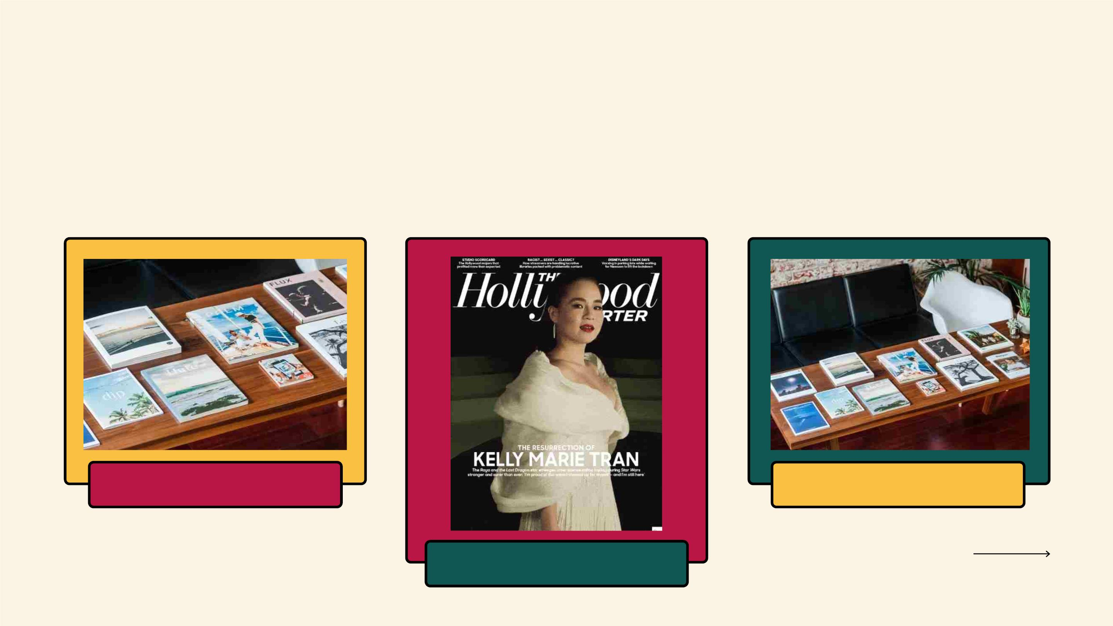
Personal Project
STORYBOARD
s c e n e 0 1
s c e n e 0 3
s c e n e 0 2

Slide 6
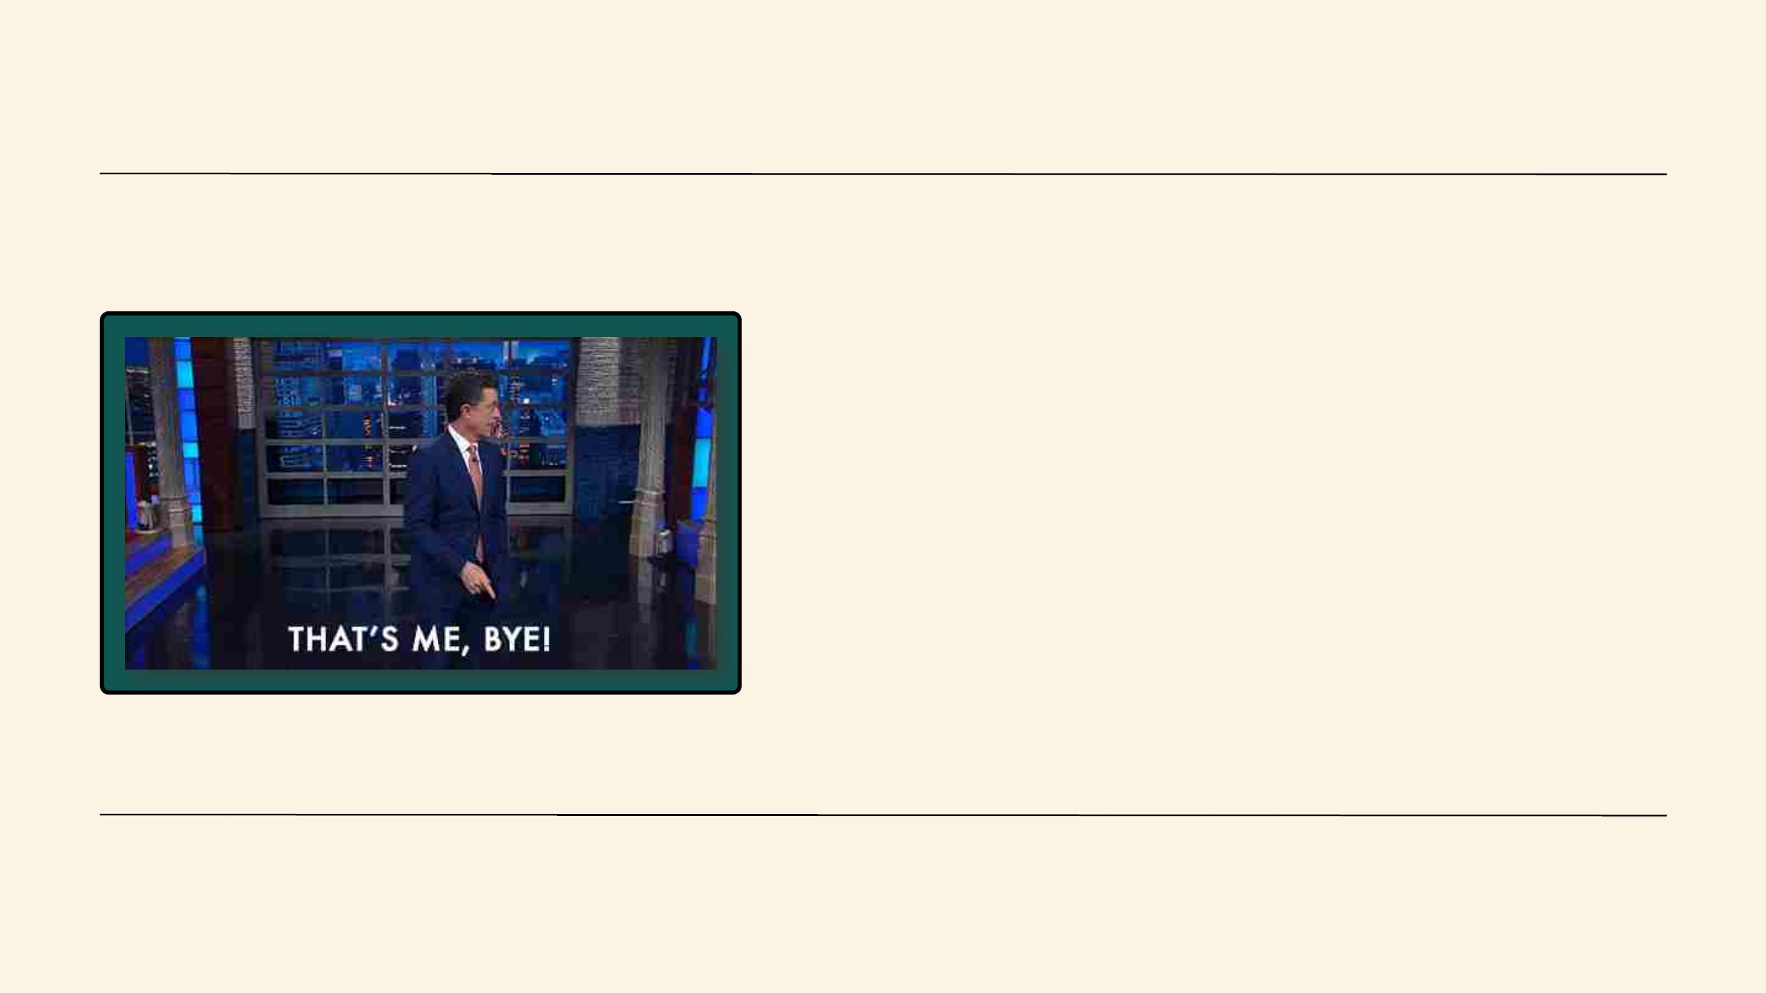
Personal Project
let's do
ok bye
this

